Slide 1
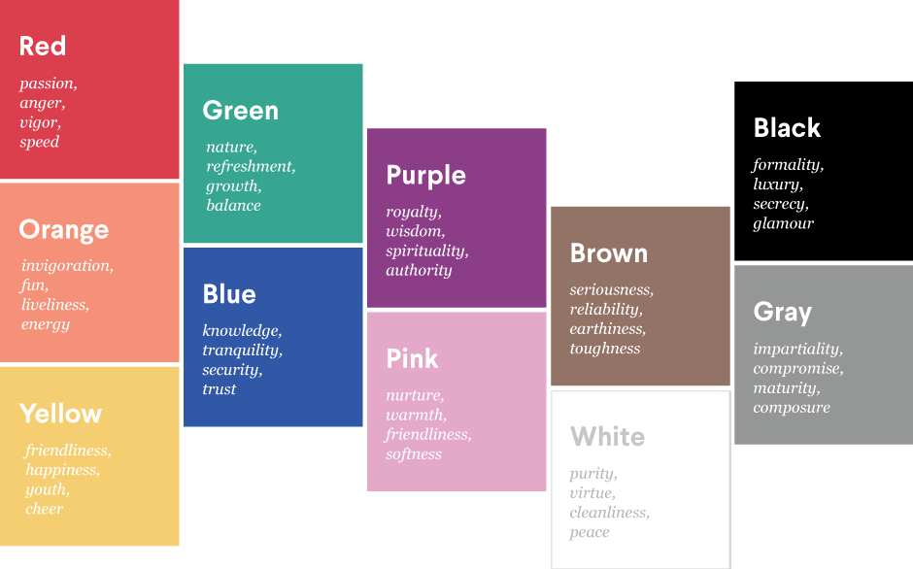




National Healthcare Providers Registry
Ayushman Bharat
Presentation By
Kunal Arora, Program Manager, NHA
Digital Mission
Notes:
Facilitator’s Instructions:
The presentation is to brief on one of the building blocks of ABDM, the Healthcare Professional Registry. The registry is to include healthcare professionals on the ABDM platform.

Slide 2
ABDM - Registries
01
Health Facility Registry
ABHA Number
03
14-digit unique identifier to create longitudinal health records of people
Supported by ABHA App available on Android and iOS
List of verified facilities
12-digit unique No. to facilities
ABDM Registries
02
Healthcare Professional Registry
04
Drugs Registry
List of verified professionals
14-digit unique No. to professionals
List of verified drugs
Unique code to each drug and strips

Slide 3








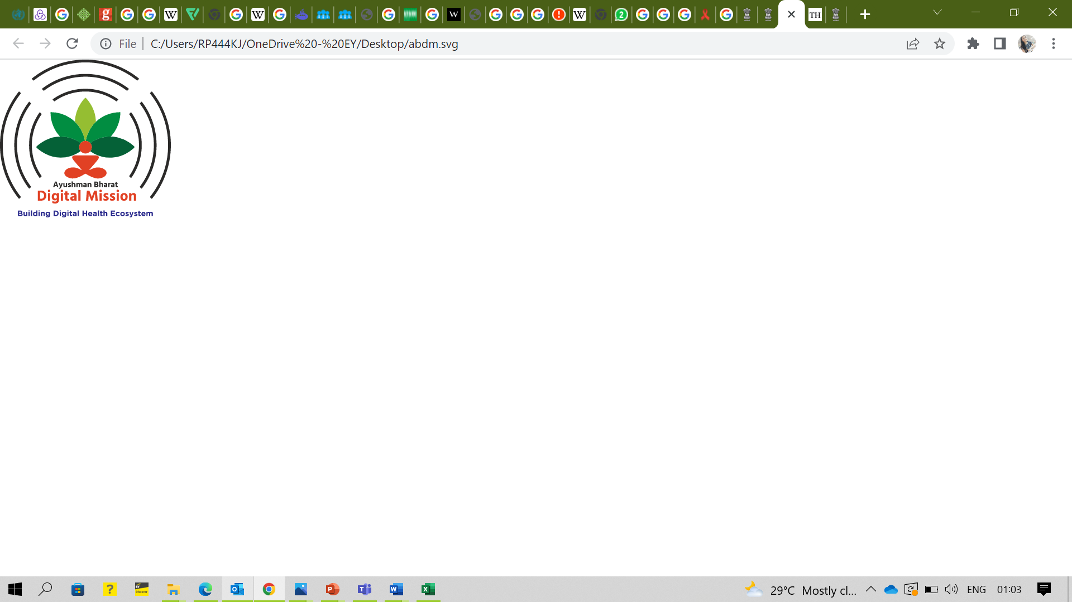
National Healthcare Providers Registry (NHPR)
National Healthcare Providers Registry (NHPR) is a comprehensive repository of registered Healthcare Professional and Health Facility.
Healthcare professionals with different system of medicines (Modern medicine, Dentistry, Ayurveda, Unani, Siddha, Sowa-Rigpa, Homeopathy) and Nurses practitioners delivering healthcare services across India.
Health Facilities like hospitals, clinics, diagnostic laboratories and imaging centers, pharmacies, blood banks, etc.
This registry envisioned to serve as a single source of truth for information

Slide 4
NHPR Platform for?
NHPR can include a broad range of Healthcare Professionals and Health Facility which are involved with health services delivery either directly or indirectly.
List of Healthcare Professional Categories
Patient Facing HP Categories
Doctors (Modern Medicine, Dentist, Ayurveda, Unani, Sowa-Rigpa, Sidha, Homeopathy)
Nursing Professionals
Heath Facility includes
Categories
Hospitals, clinics, diagnostic laboratories and imaging centers, pharmacies, blood banks, etc.

Slide 5




Why NHPR
Existing Challenges
How NHPR Solves These Challenges
Covers both public and private – Doctor/Nurses
Not Universal - No existing database in the country covers the entire set of healthcare professionals and Health Facilities comprehensive set of information
Across all System of Medicine
Covers both public and private health facilities
Data updated by Users (Healthcare Professionals or Health Facility Managers)
Lack of Trust & Transparency - Data in existing registries is often unverified and not updated in real-time, making them significantly less usable
Audit logs and versioning
Data verified by Councils/Governing Bodies

Slide 6




12 June 2023
age 2
Benefits of NHPR
1.Online Presence & Discoverability: Ease of discovery, verified profiles on a national platform instilling trust
2. Unique & Trustable Identity: Provision of unique HP ID to connect with all stakeholders of the healthcare ecosystem.
3. Teleconsultation: With ABDM, doctors can engage with more patients, both in-persona and through tele-consultation
Online Presence
& Discoverability
Unique & Trustable Identity
Teleconsultation
Digital Doctor Certificate
Other Benefits
5. Other Benefits: (After Profile Verification)
Healthcare Professional can participate in United Heath Interface (UHI), Healthcare Workforce Mobility Portal,
Medical Certificate
4. Digital Certificate: Digital Doctor certificate (once verified) and Digital Facility Certificate (once Verified)

Slide 7

National Healthcare Provider Registry Merging of HPR & HFR into single Portal named as “National Healthcare Provider Registry” Roles:- a. Healthcare Professional b. Facility Manager /Administrator c. Healthcare Professional & Facility Manager
Registration Process
https://nhpr.abdm.gov.in/home

Slide 8
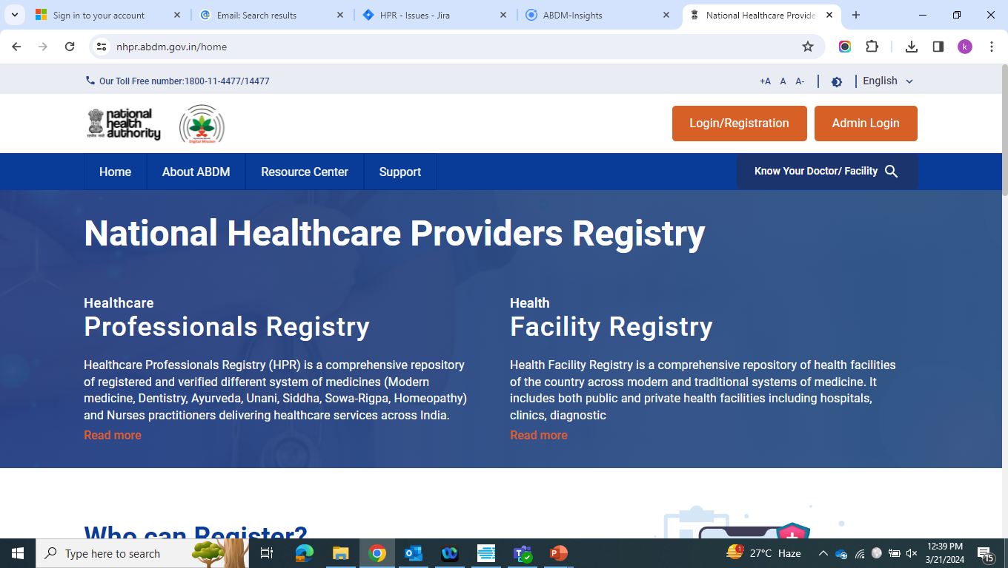

User clicks on Login/ Registration button

Slide 9
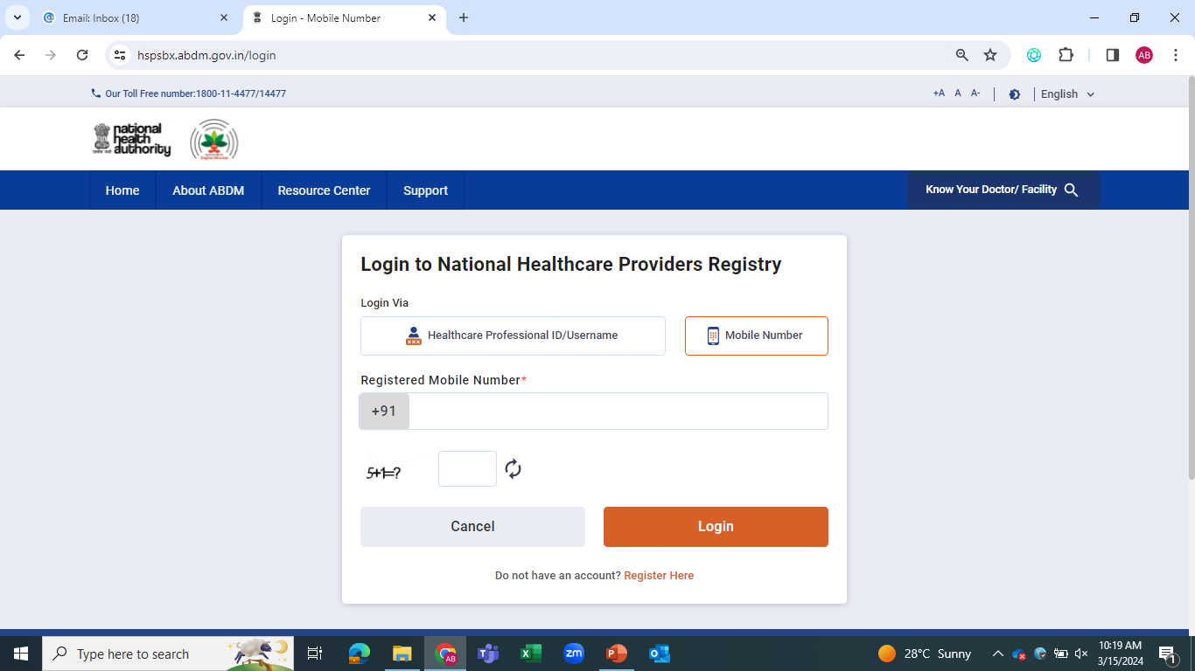
New user will click on Registration button

Slide 10
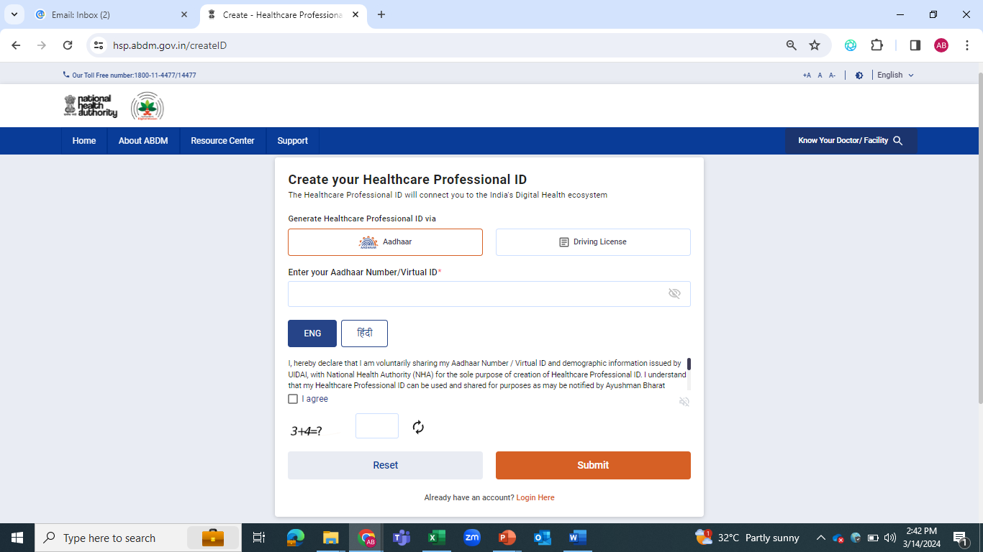
The user will select Aadhaar as an option to create HPID

Slide 11
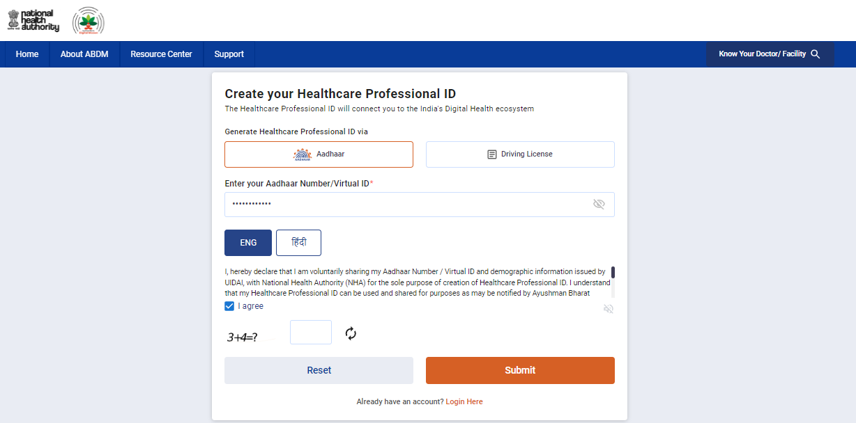
The user will enter their Aadhaar number and click on the Submit button

Slide 12
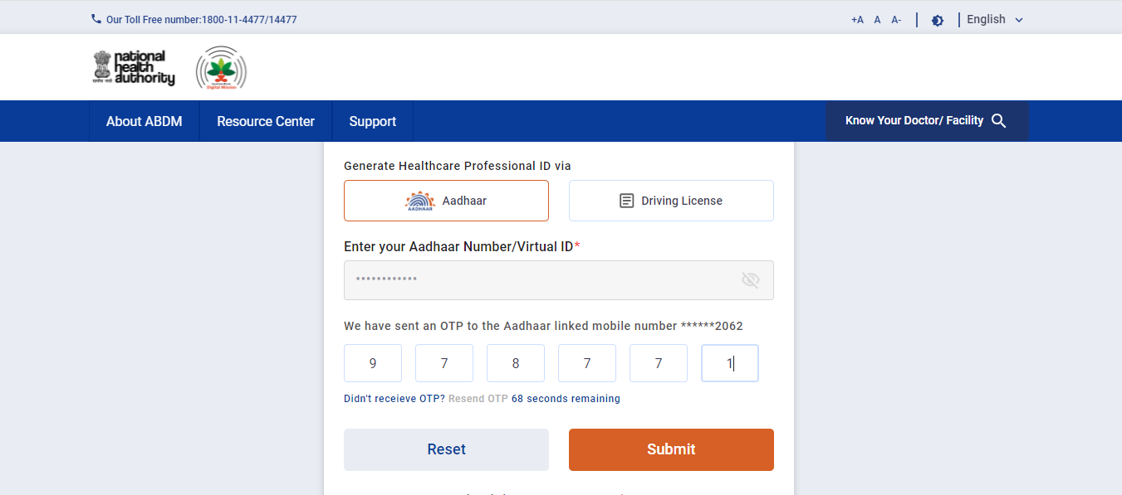
Enter the OTP sent to the Aadhaar-linked mobile number and Submit

Slide 13
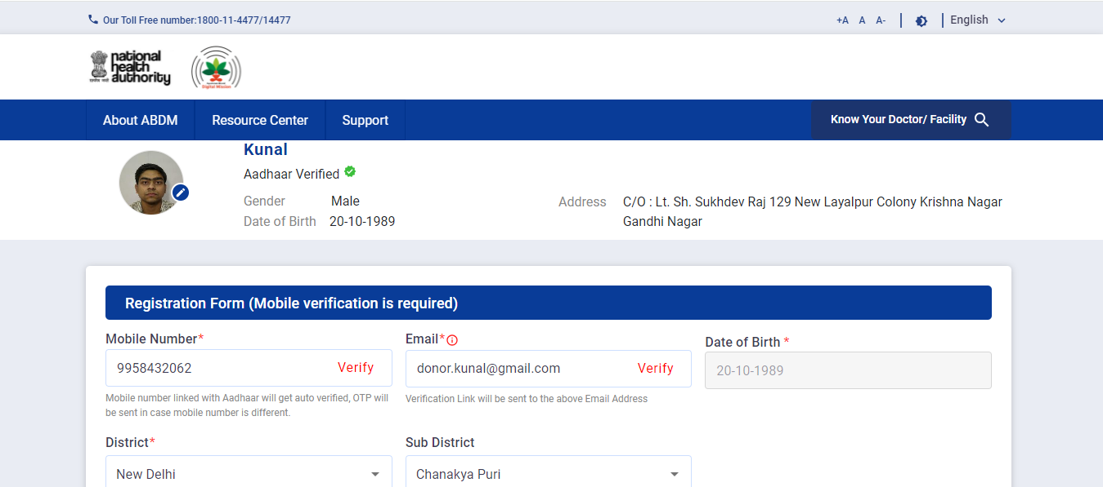
*********
The user would enter the mobile number and email address
***
*********
*********
**

Slide 14
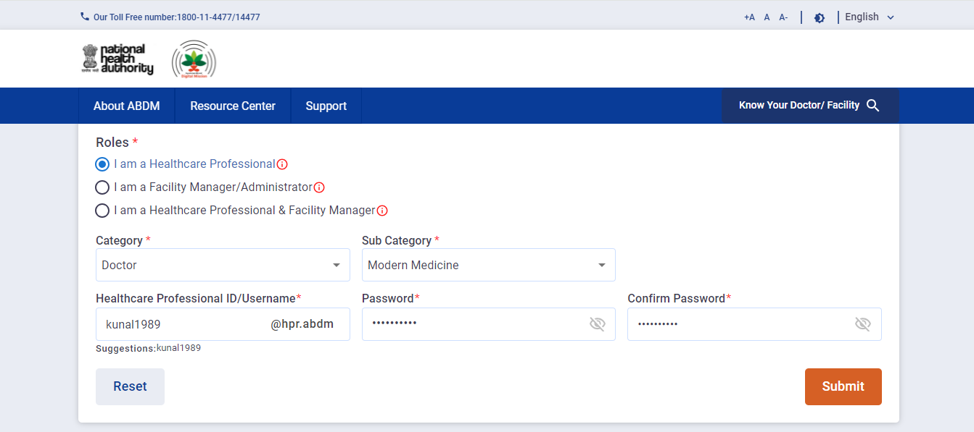
The user will select their role and enter the category, sub-category.
After entering the password, the user will click on Submit button

Slide 15
Healthcare Professional Registration

Slide 16
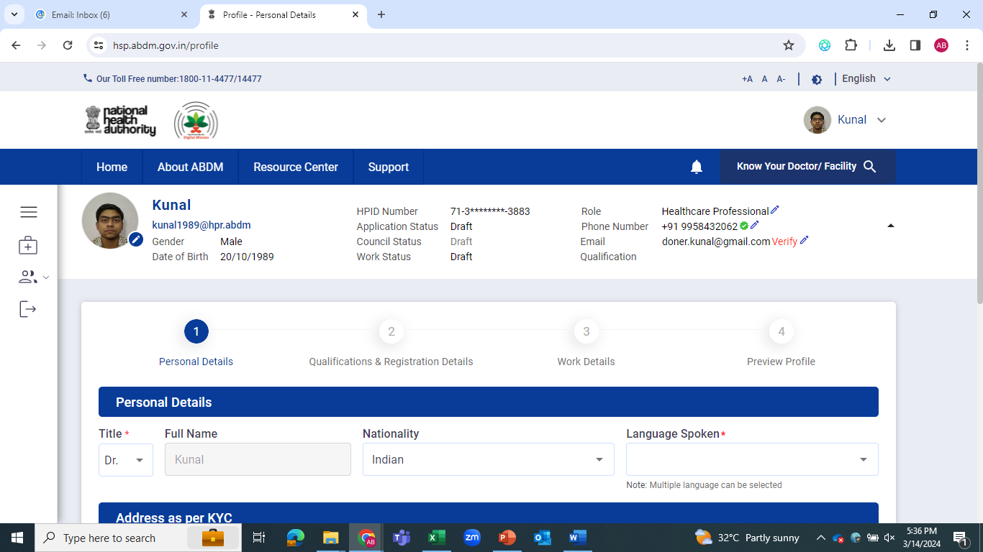
***
**
***
Steps to register on the portal

Slide 17
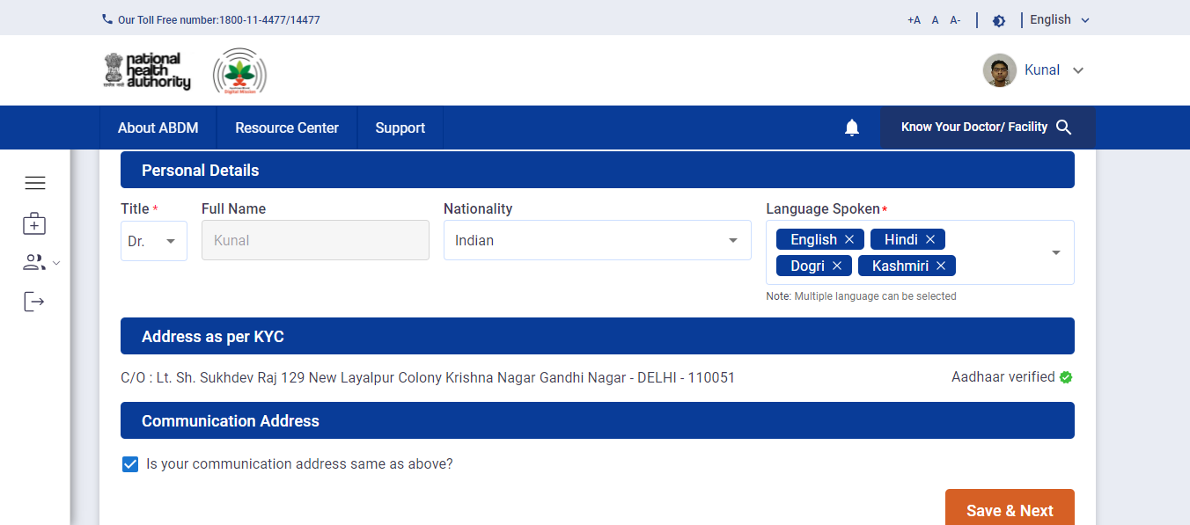
Enter the Multiple languages
Click on Save and Next to move to next page

Slide 18
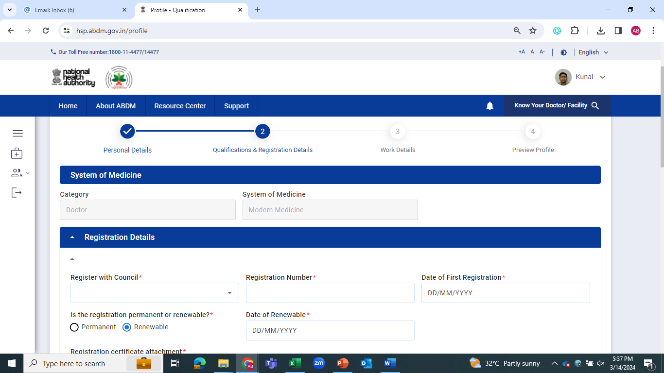

Slide 19
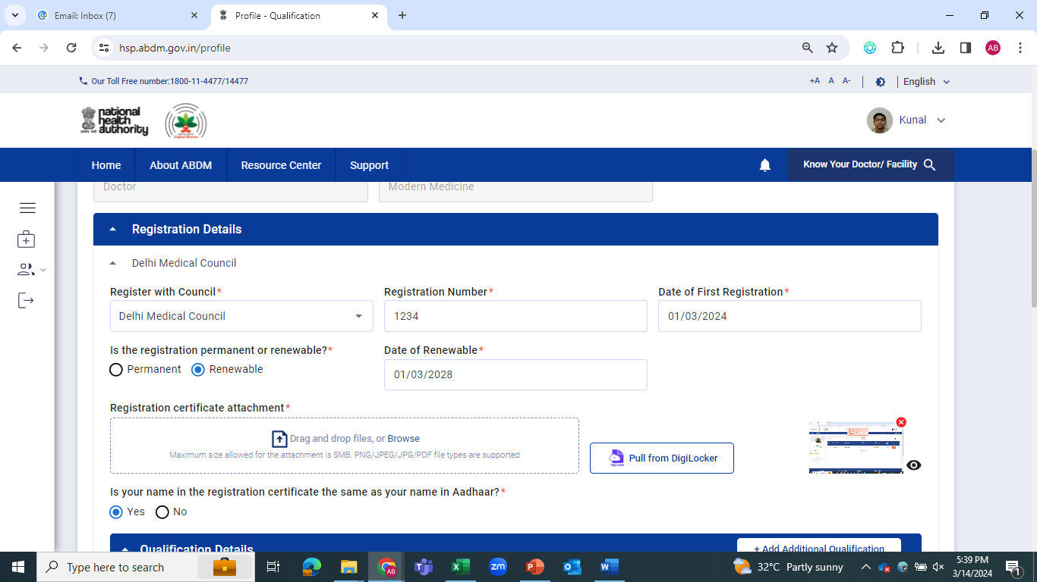
Enter the Registration Details

Slide 20
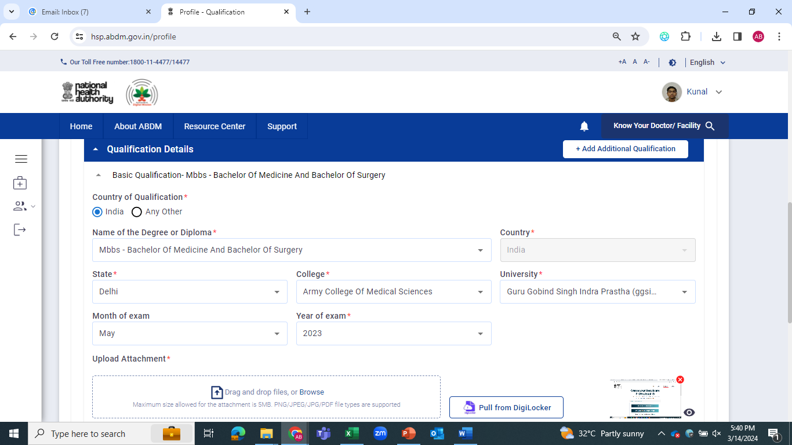
Enter the Qualification Details

Slide 21
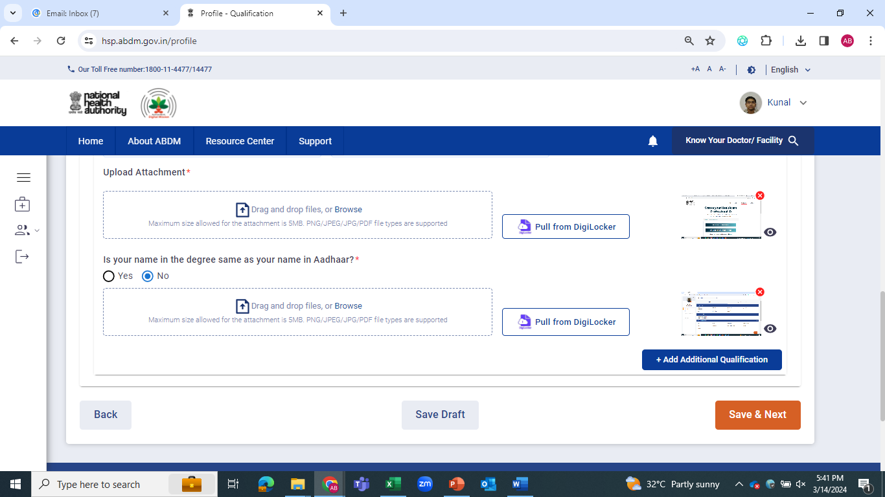
Click on Save and Next to move to next page

Slide 22
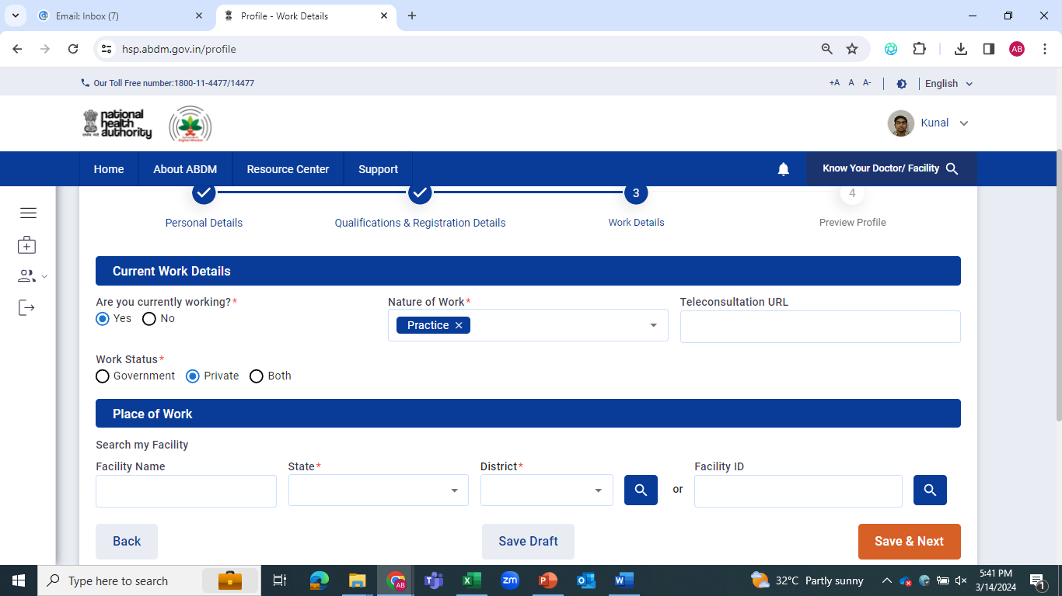
Enter the Work Details
In case of Government professional, facility declaration is mandatory
Click on Save and Next to move to next page

Slide 23
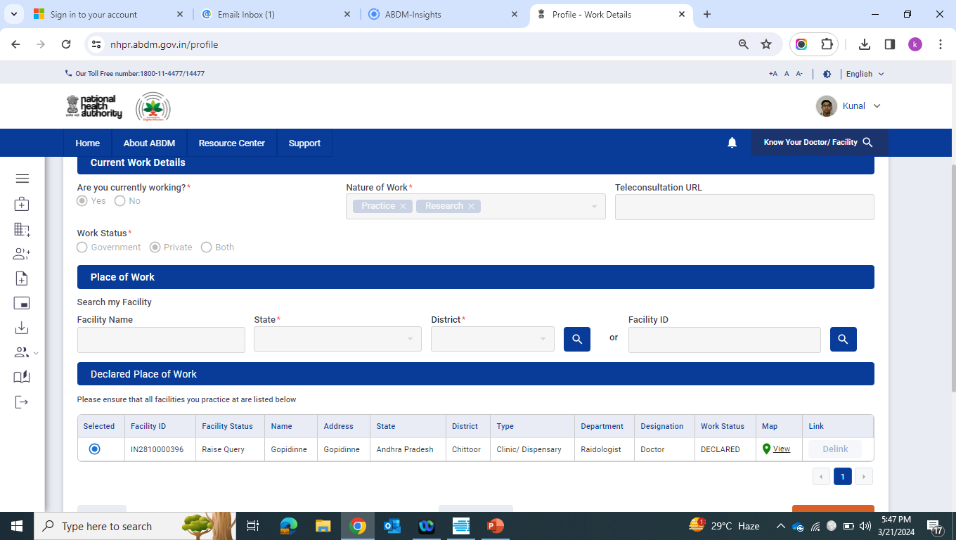

Slide 24
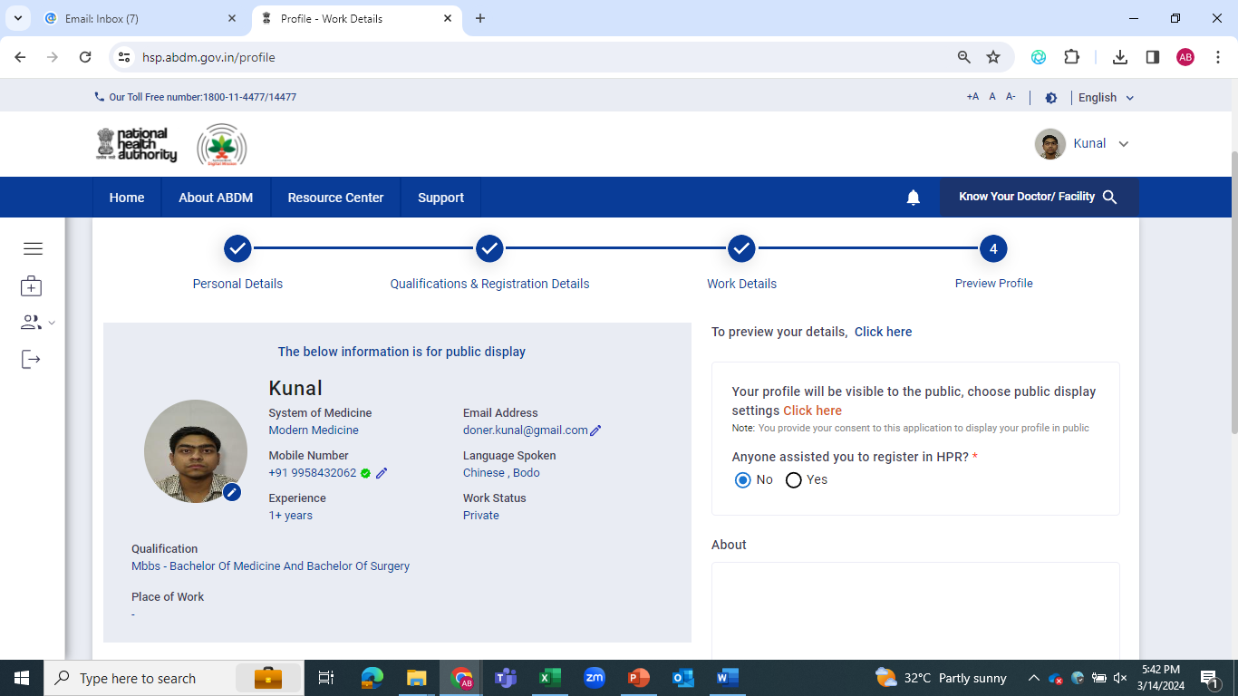

Slide 25
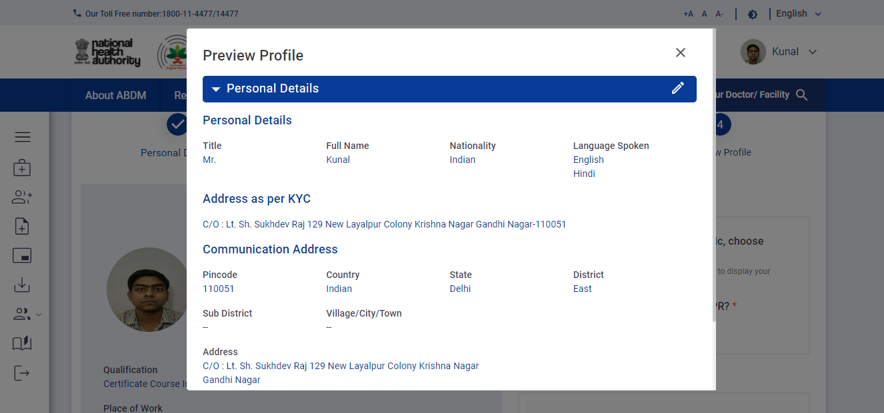

Slide 26
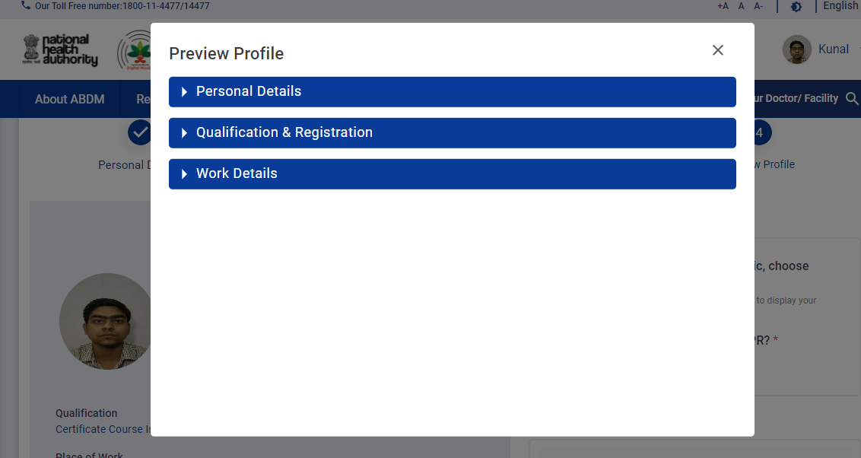

Slide 27
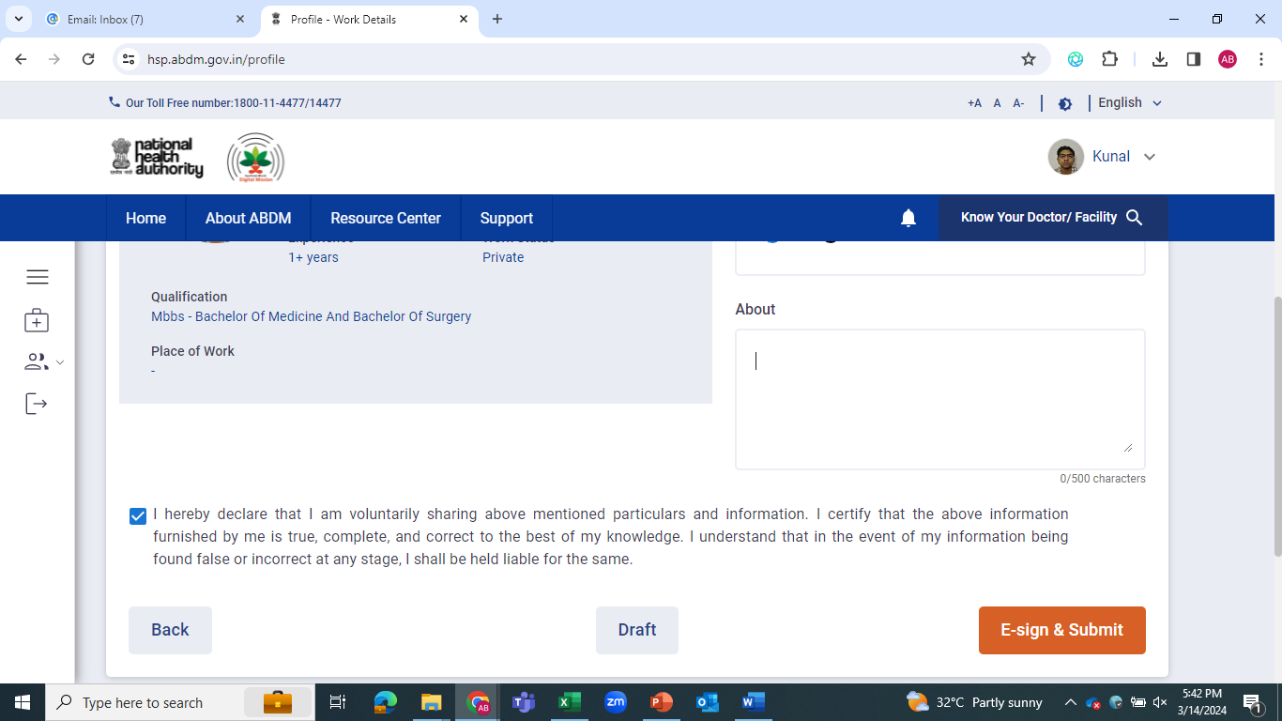
Click on E-sign and Submit

Slide 28
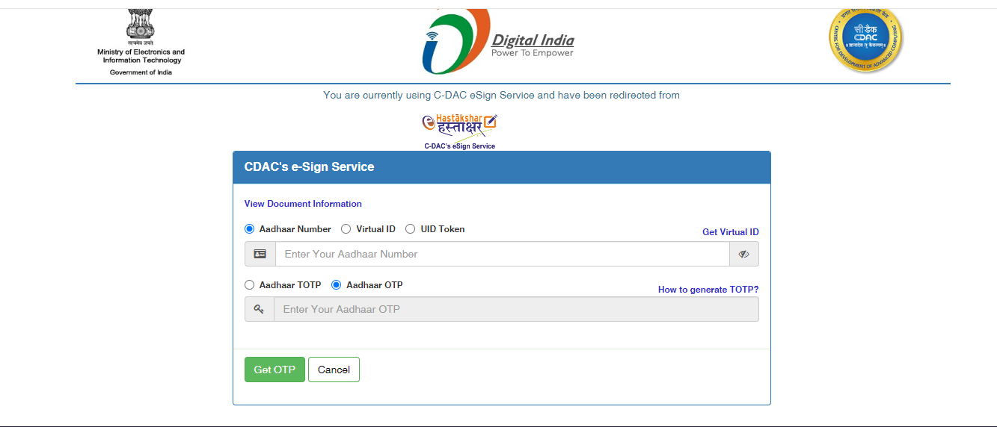
Enter Aadhaar Number
Click on Get OTP Button

Slide 29
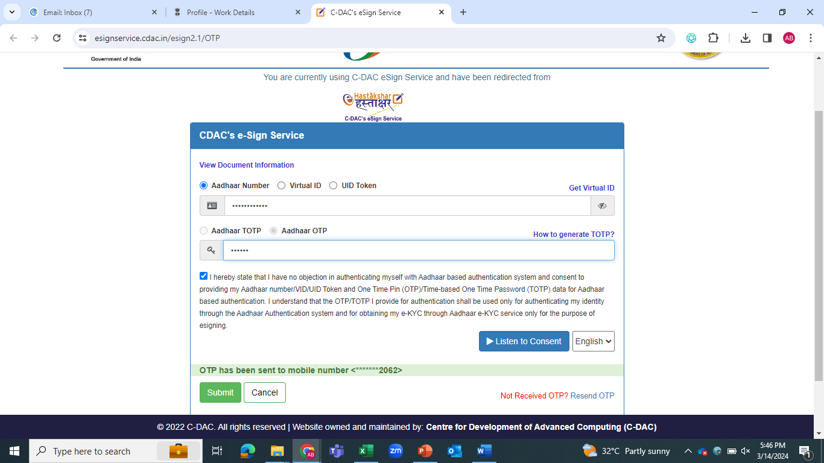
Enter the OTP received on the registered mobile
Click on Submit Button

Slide 30
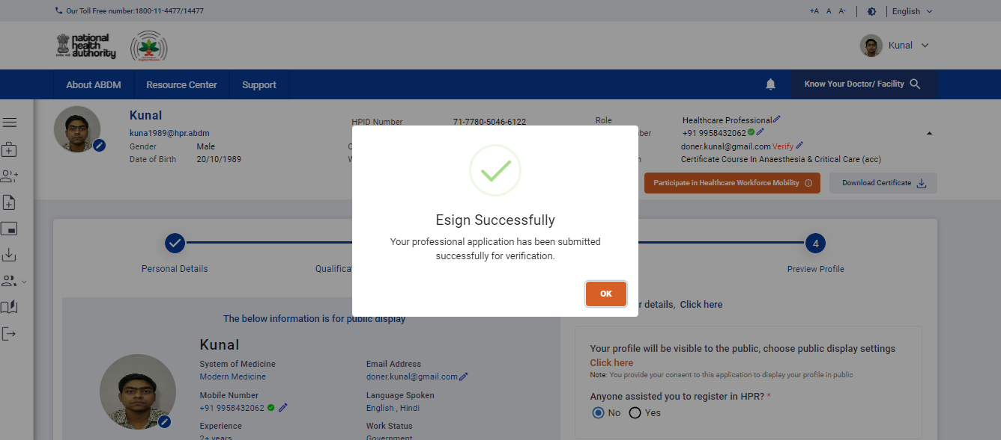
Click on
OK Button

Slide 31
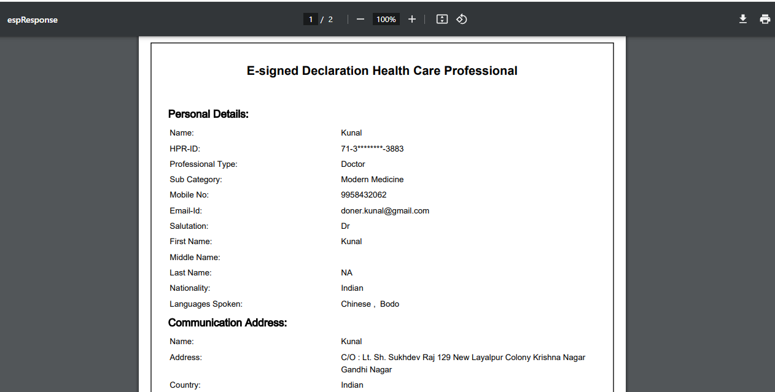
This document is downloaded after successful e-sign and submit of the Healthcare Professional Application

Slide 32
After Verification by Council/State Government

Slide 33
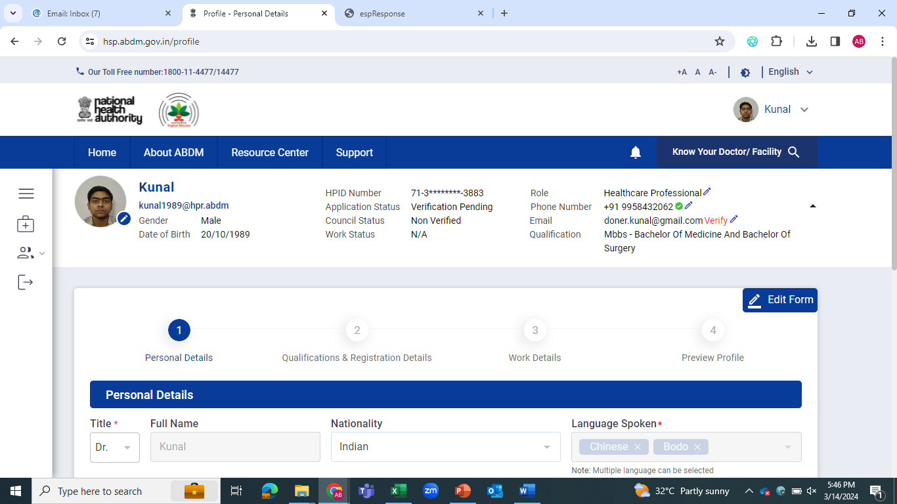
You can Edit Form from here

Slide 34
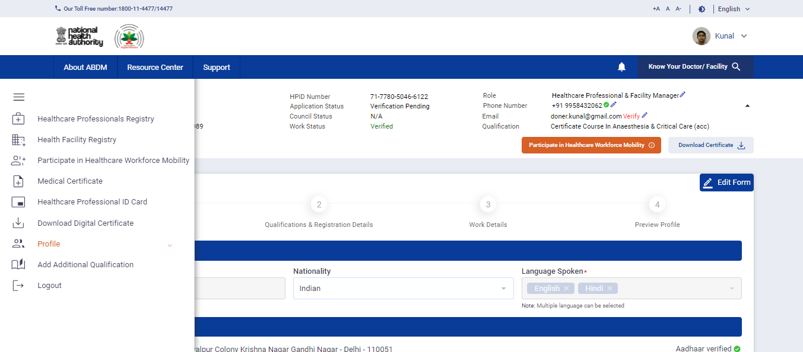
Participate in Healthcare Workforce Mobility, Medical Certificate, Download Digital Certificate and Additional Qualification buttons are visible after the verification from the concerned authority.

Slide 35
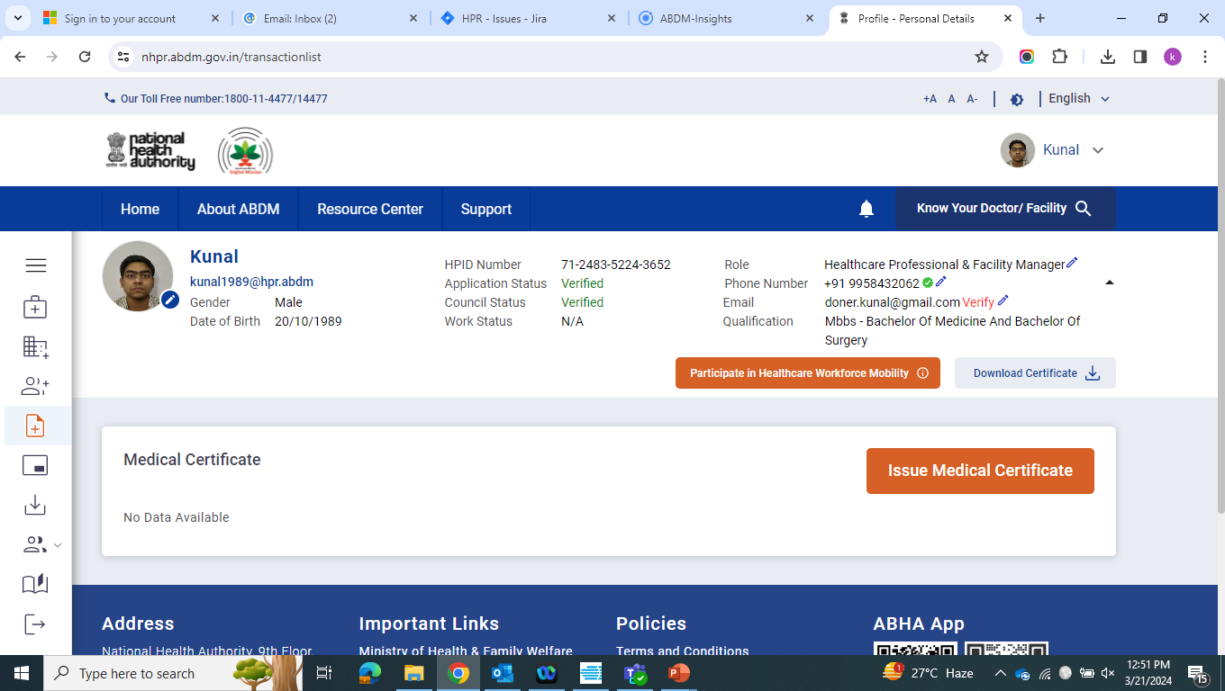
Healthcare Workforce Mobility– (Professionals can participate in Healthcare Workforce Mobility Portal)
Click Here to Participate

Slide 36
Medical Certificate – (Modern Medicine Doctor can provide medical certificate)
You can click here

Slide 37
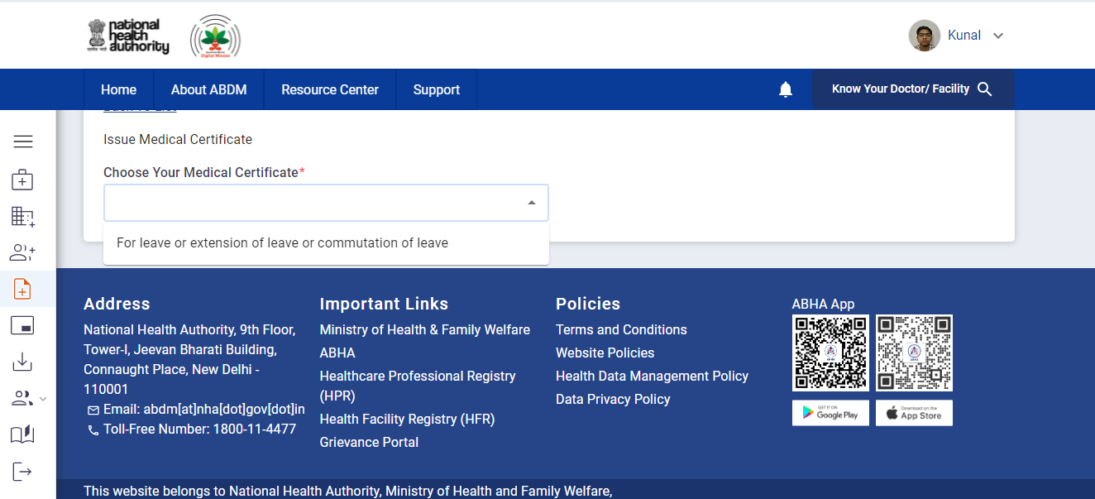
Medical Certificate (Contd..)
You can click here

Slide 38
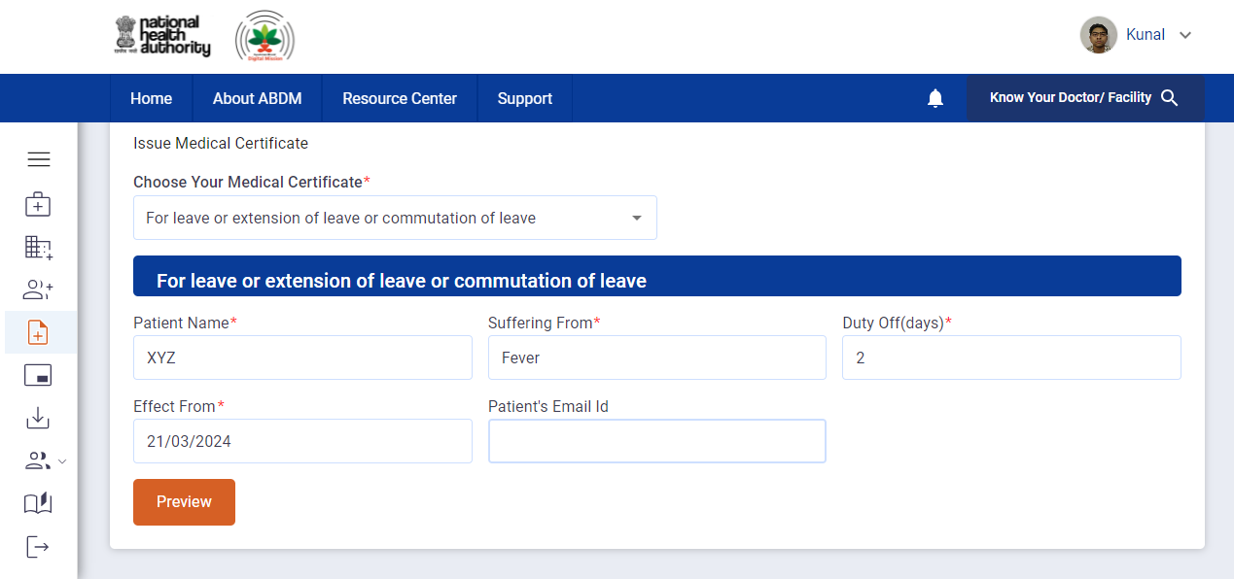
Medical Certificate (Contd..)

Slide 39
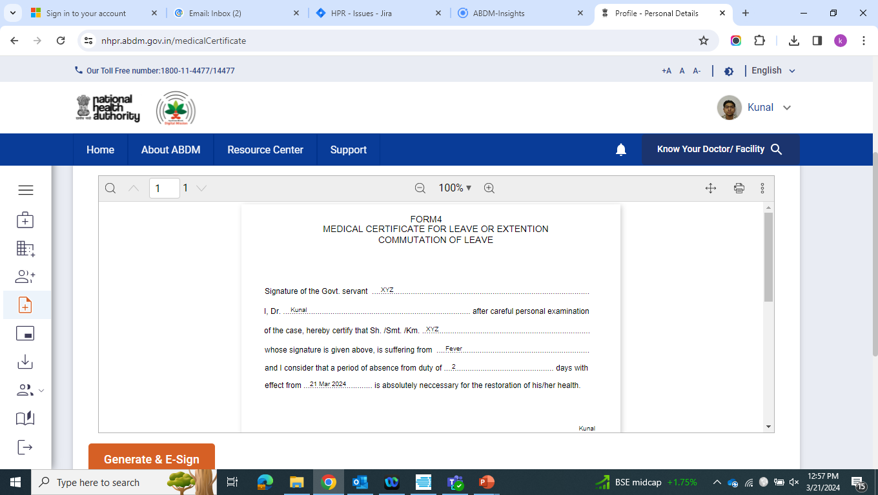
Generate & E-sign Medical Certificate

Slide 40
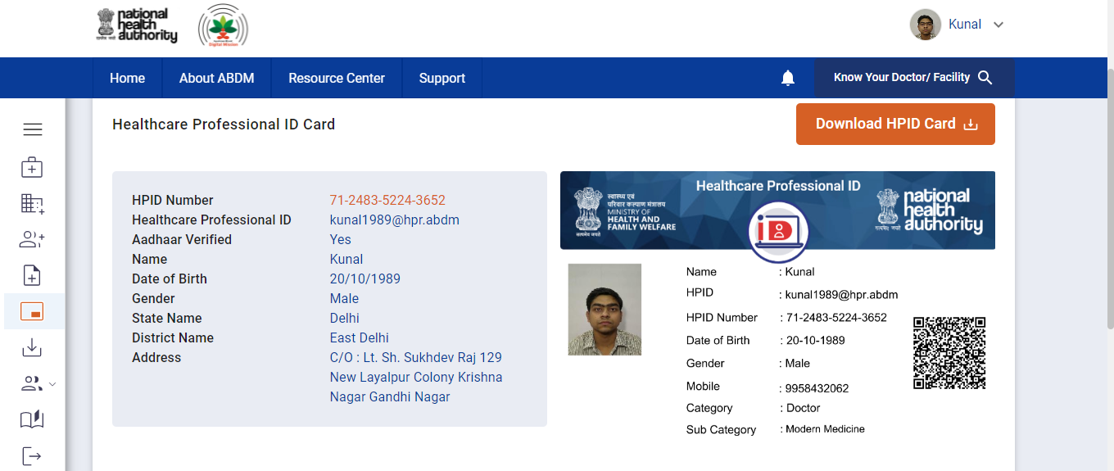
Download Healthcare Professional ID Card

Slide 41
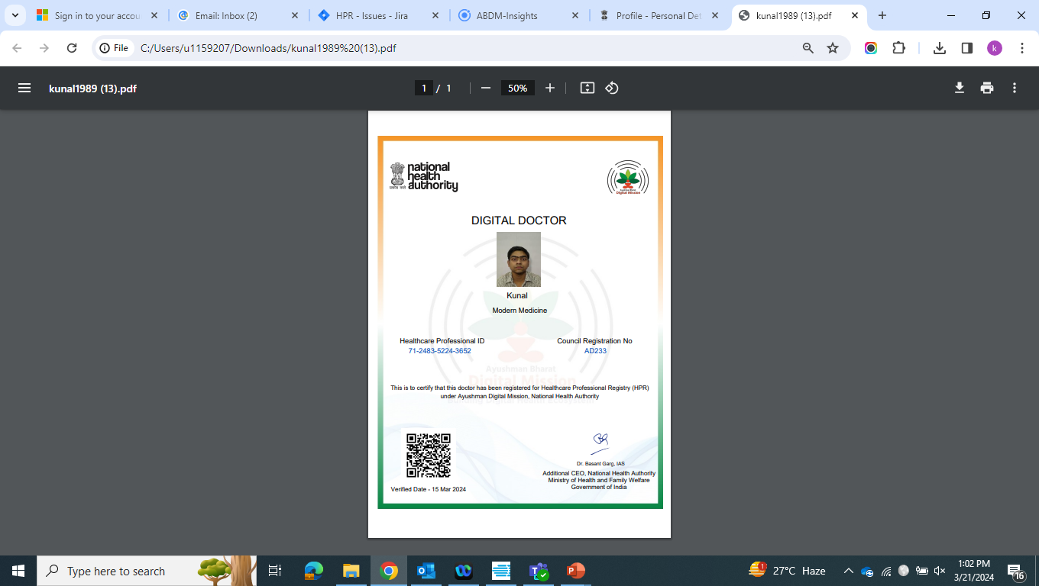
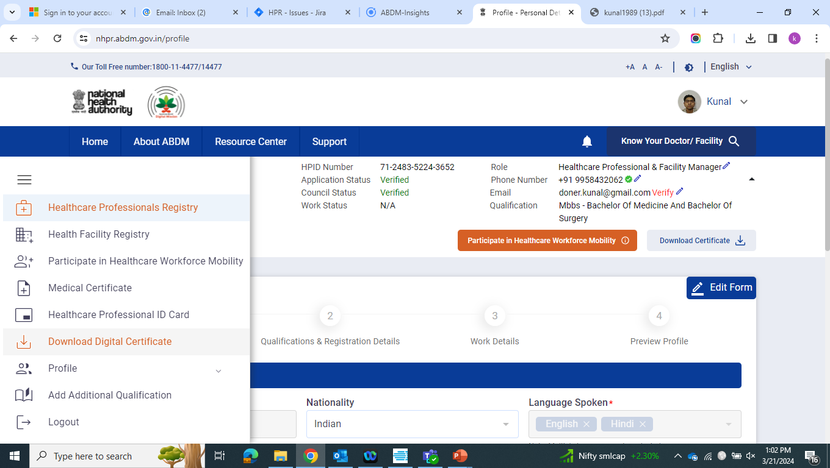
Download Digital Certificate

Slide 42
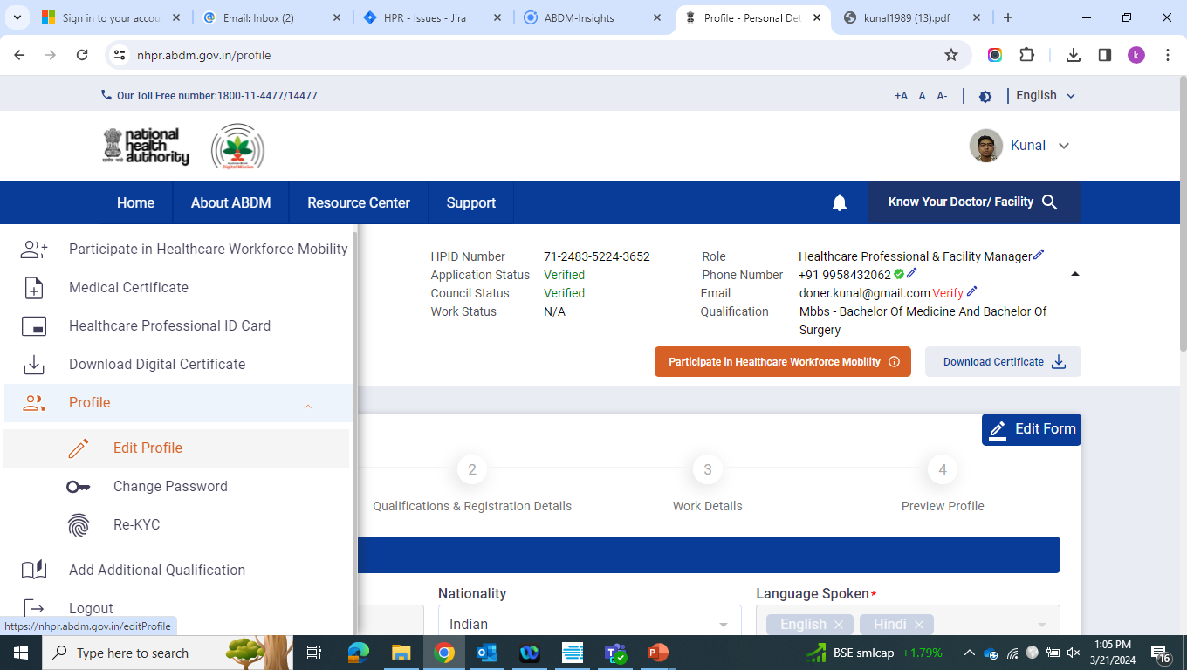
Edit Profile

Slide 43
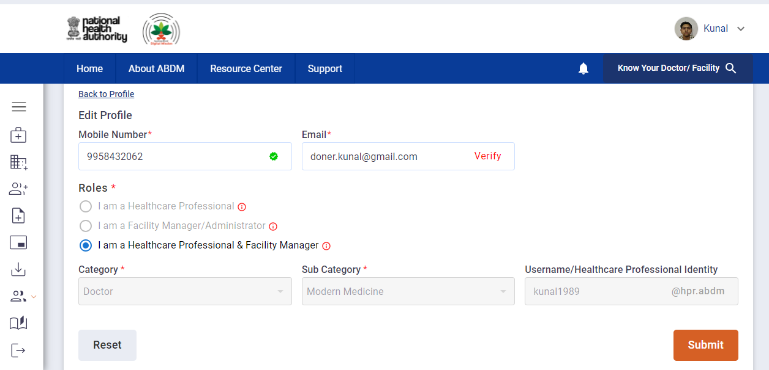
Edit Profile (Contd..) – Professional can change the mobile number, Email id & Role

Slide 44
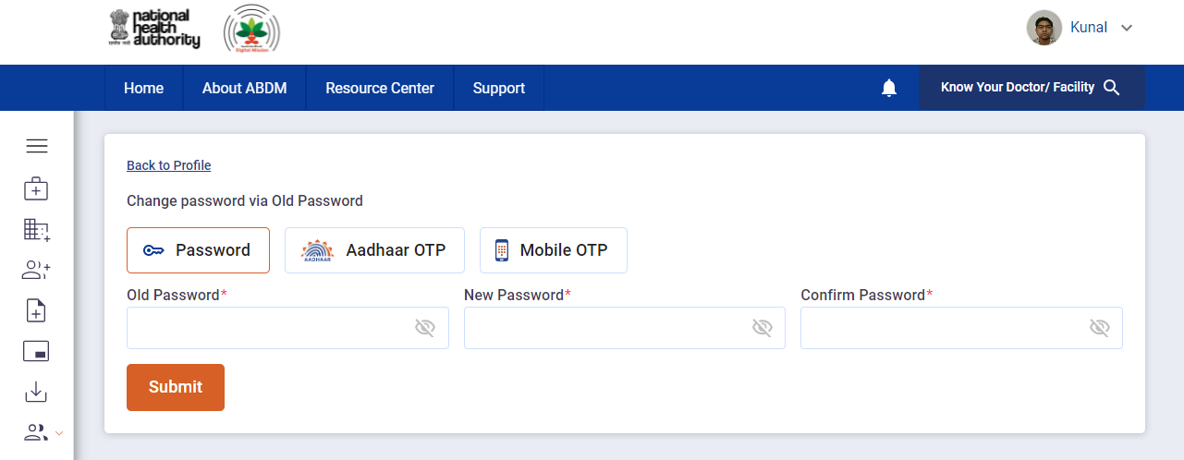
Change Password Professional can change the password via Old Password/ Aadhaar OTP / Mobile OTP

Slide 45
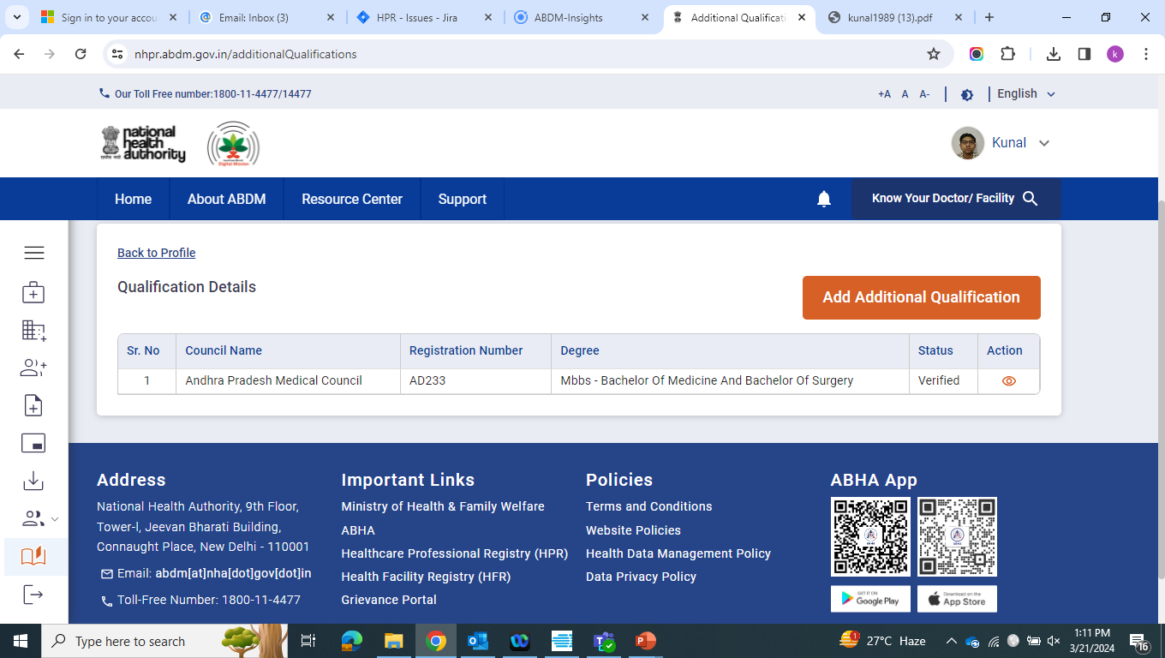
Additional Qualification

Slide 46
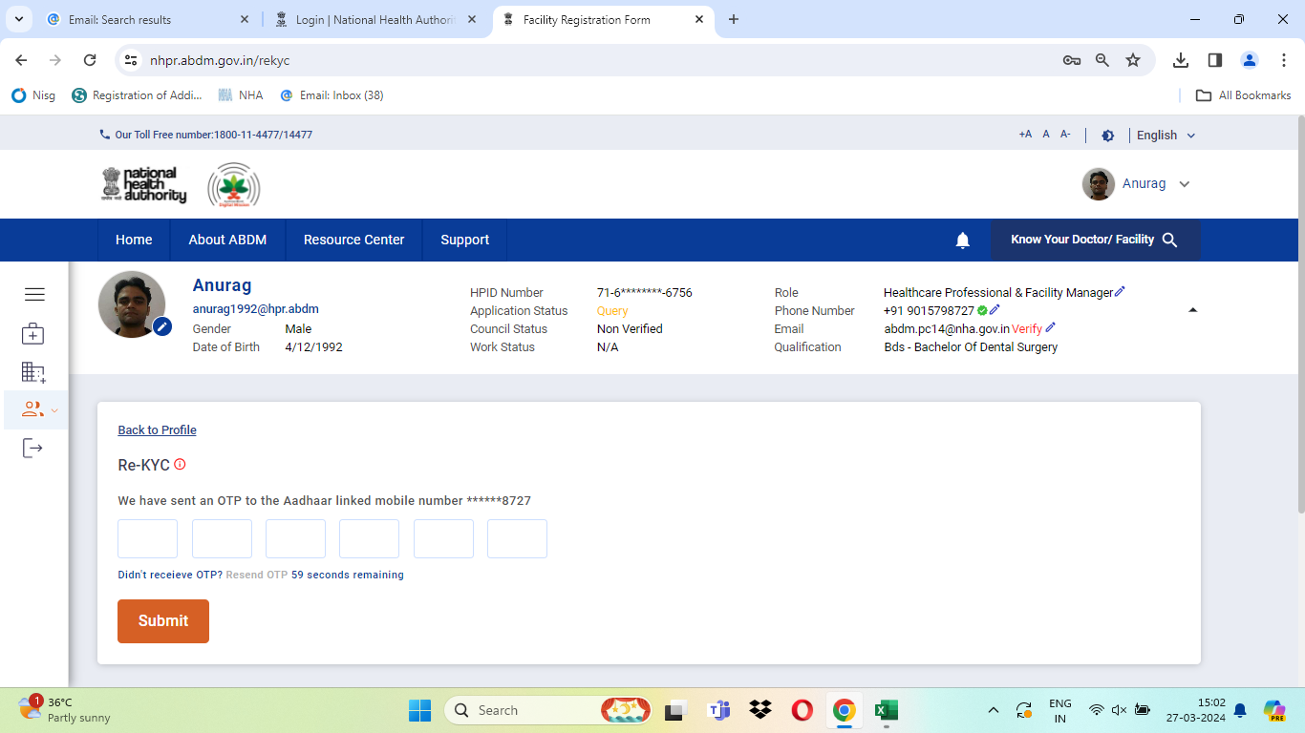
Re-KYC

Slide 47
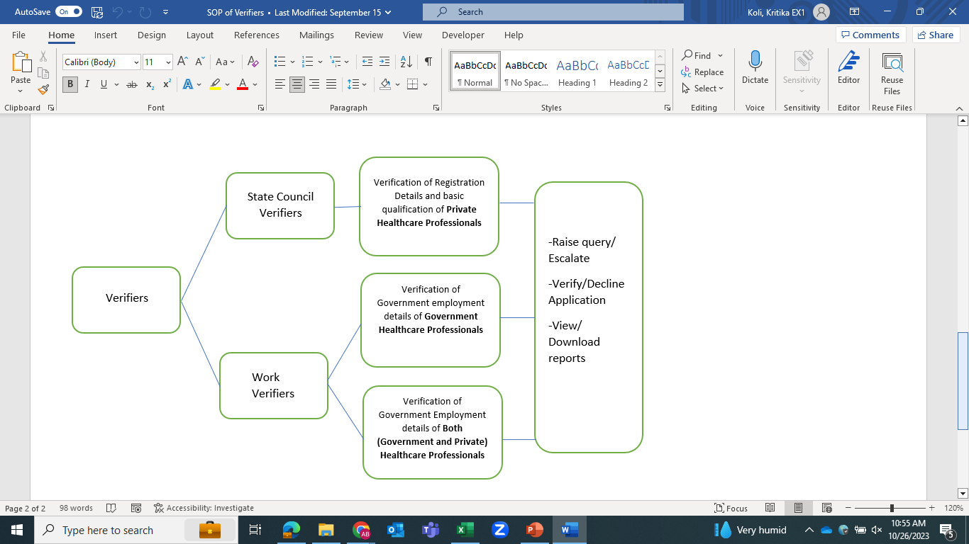
New HPR Application Verification Process
S. No. | Professional | Council Verifier (Qualification & Registration Detail) | State Government Verifier (Qualification, Registration Detail& Work detail) | Overall Verified
a) | Government
b) | Private
c) | Both (Government and Private)

Slide 48
Health Facility Registration

Slide 49
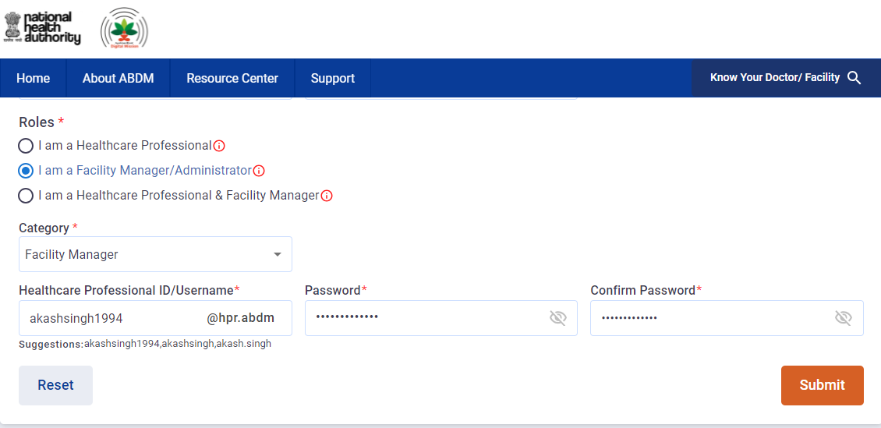
The user will select their role and enter the category, sub-category.
After entering the password, the user will click on Submit button

Slide 50
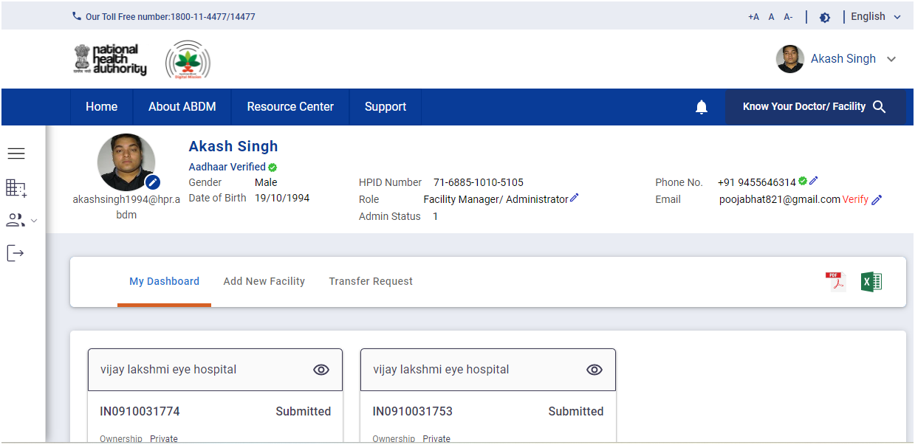
Add New Facility
The user can add the New Facility .

Slide 51
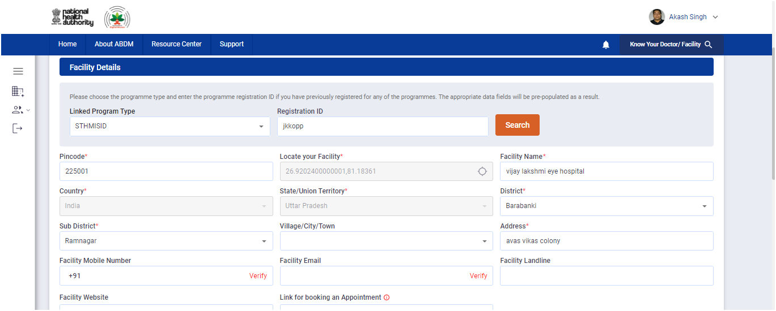
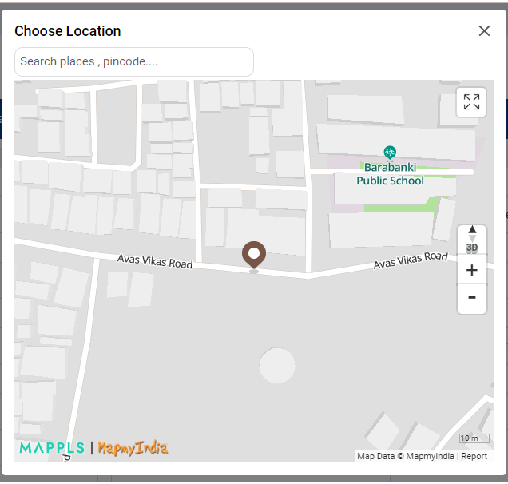
Enter the Pincode and Click on the map icon present on the right side of the Locate your Facility.
The Map would open, where you can search your facility by either entering the name of the Facility or by drag, drop and clicking on the Balloon Icon.

Slide 52
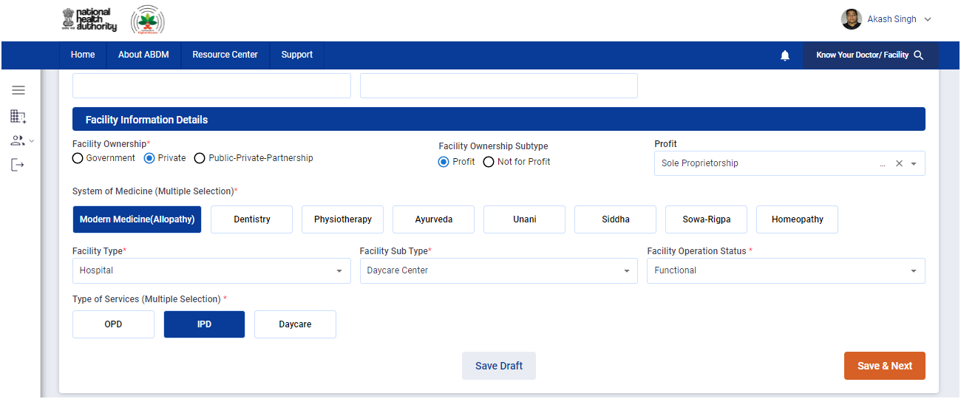
Click on Save and Next

Slide 53
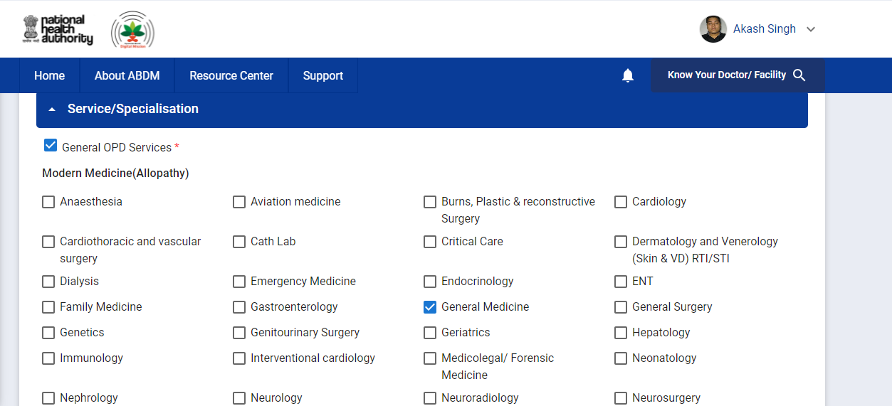
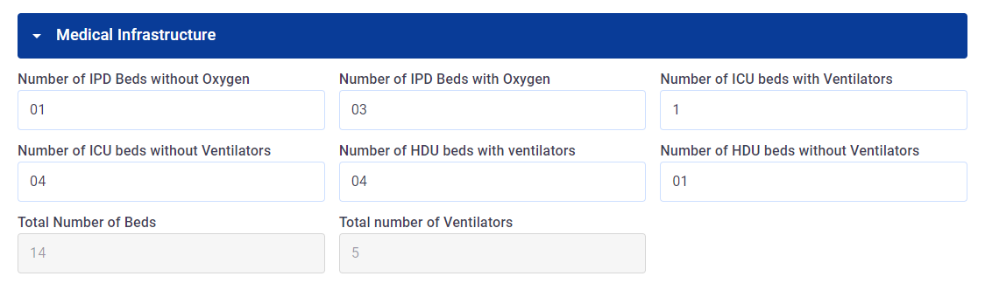
These fields are auto filled

Slide 54
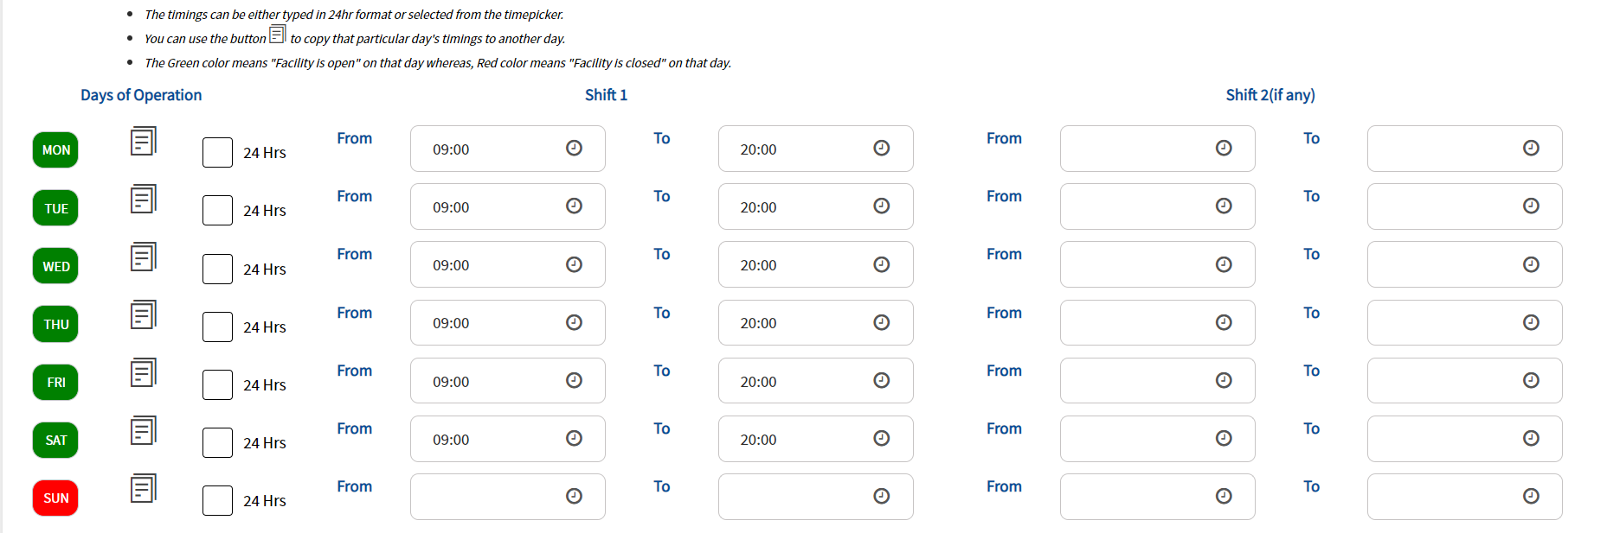
Contd….

Slide 55
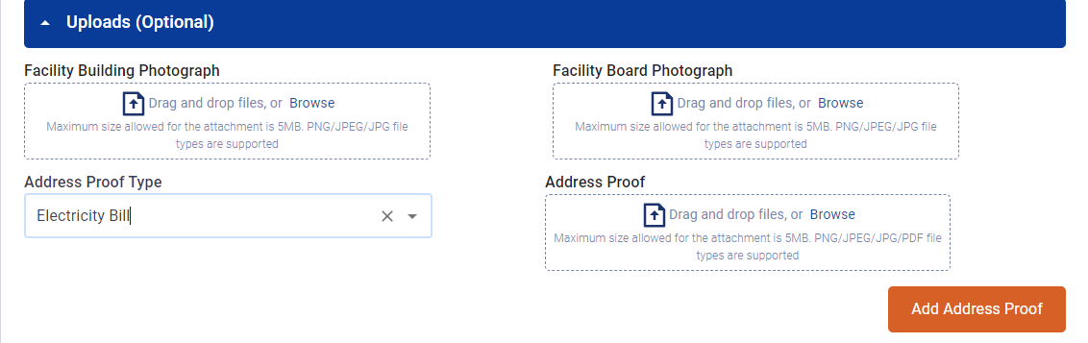
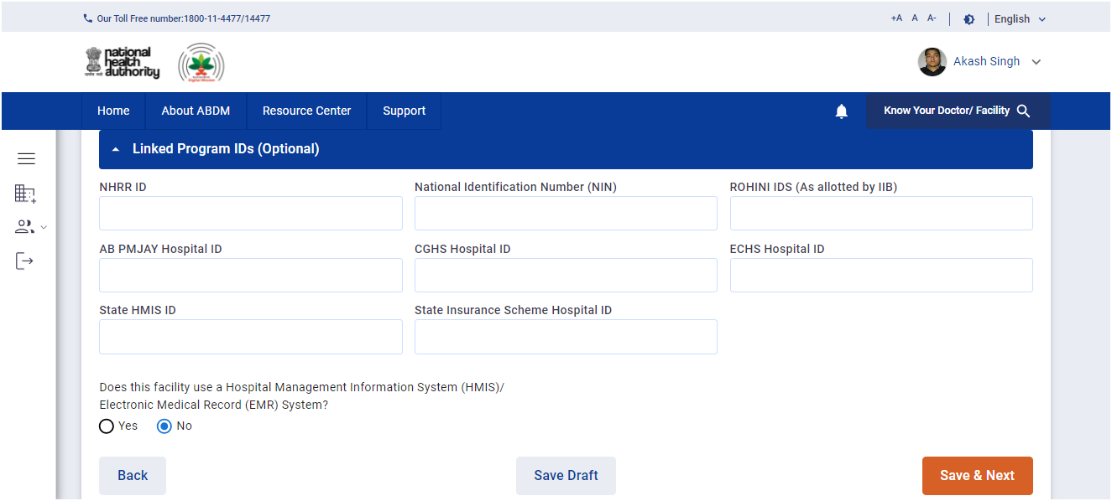

Slide 56

Enter the details of your Facility

Slide 57


Slide 58

Click on E-sign and Submit

Slide 59
Enter Aadhaar Number
Click on Get OTP Button

Slide 60
Enter the OTP received on the registered mobile
Click on Submit Button

Slide 61

PDF generated after the successful submission of the Facility

Slide 62

Facility ID
Is created and Submitted for Verification..

Slide 63


Digital Certificate
Only For Approved Facility…

Slide 64

Software Linkage
After creation of Facility

Slide 65


Enter the Bridge ID provided to your health facility by the HMIS provider
The detail would be auto fetched, verify and click on the checkbox

Slide 66


Slide 67




Generate QR code
Click on manage QR
Step 1
Step 2
Add the counter number/name in the space provided, select category and click on “generate QR”
Step 3
QR code generated

Slide 68
Add Healthcare Professional
After creation of Facility

Slide 69


Slide 70

User can search professional through Healthcare Professional Id or Name and Mobile number.

Slide 71



Slide 72
Transfer The Facility
Click to transfer the facility
After creation of Facility

Slide 73

Select the facility to transfer and enter the Healthcare Professional ID

Slide 74



Slide 75

Accept/Reject the facility transfer request
Click to transfer the facility

Slide 76
12 June 2023
age 2
How to create HP ID:
Scan the QR code to create HPR
1
Scan the QR code or visit https://nhpr.abdm.gov.in to apply for HP ID using Aadhaar
Fill the registration form using personal, registration and work-related details for Healthcare Professionals
Fill the registration form using Facility details for Health Facility
Review and submit the form to for verification
2
3
4

Slide 77
Thank You

